Slide 1
Situation Overview

Slide 2
Situation Overview
Poor earnings and business quality concerns caused investor sell-off
Recent Earnings Print
Investor Reaction
Q3 ’23: Margin compression due to costs associated with persistent high inventory
Inventory mishap hurts LT brand image
Down 300 BPs in gross margin
FY ’23: Weak FY24 earnings guidance due to macro, inventory & distribution expenses
Structurally lower profitable retailer
Projected FY loss 400 BPs EBITDA
Q4 ’24: Lower sales guidance from weak consumer demand and margin reduction
Poor operations in macro backdrop
Revision of 6-7% decline in sales
High levels = High costs
Management ordered inventory too early
Down ~50% YTD

Slide 3
Situation Overview
Sell-side’s short term view creates an attractive investment opportunity
Do we believe current issues are short-term?
Sell Side View
Variant View
Margins will fail to recover from inventory de-stocking and warehouse costs
ATZ will face difficulty recovering sales with macro affecting consumer demand
Fear of a ‘fad’ business that over-earned and will gradually lose wallet share
Inventory situation is transitory and will subdue in the near-term
Macro environment and consumer demand will eventually normalize
ATZ historical success is not fad-driven with several brand execution factors
Conviction in LT Business Quality?
Time Arbitrage Opportunity
Clear store expansion path in the U.S.
Opportunity to fully develop eCommerce
Brand durability is underappreciated
Industry leading unit economics
Institutional investors sell off stock due to depressed short term outlook
+
We have conviction that long term business fundamentals will be strong
=
Opportunity created through our time horizon
IAG’s investment philosophy is to buy high quality companies that are trading at attractive, low prices

Slide 4
Thesis 1
Clear Path to Sales Target

Slide 5
Thesis 1: Clear Path to Sales Target
Incremental revenues through expansion in U.S. whitespace

Slide 6
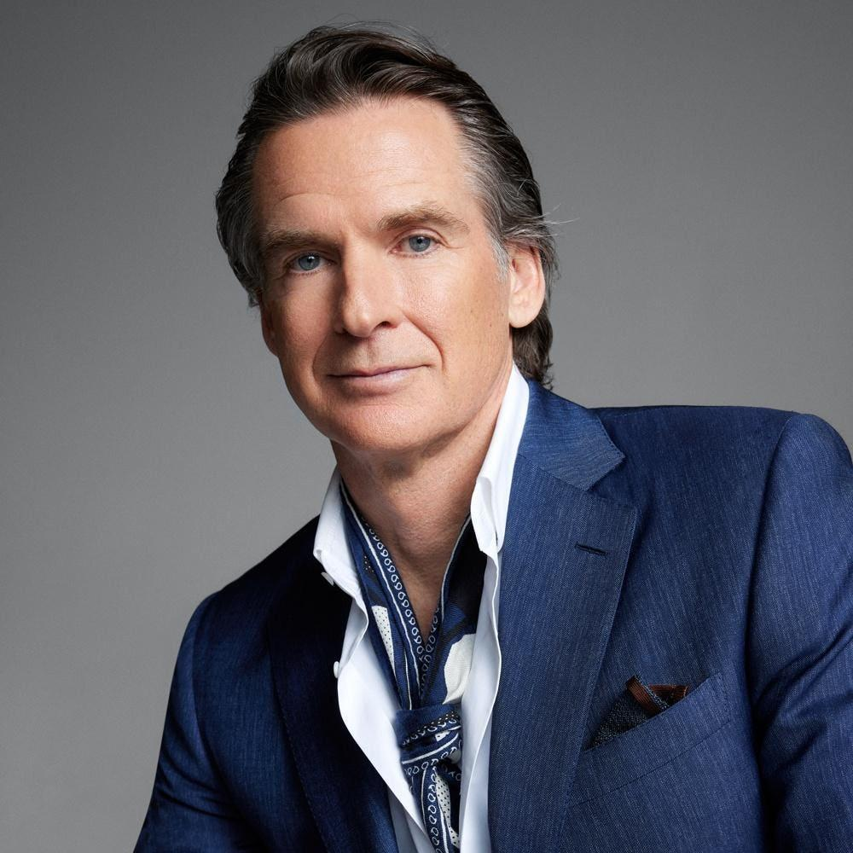

Thesis 1: Clear Path to Sales Target
Low hanging fruit with eCommerce
eCommerce Is Underdeveloped
Catalysts for eCommerce Growth
Only 35% of LTM revenue came online, lagging industry average of 45%
Ex-CEO Brian Hill’s employed conservative approach to digital platforms
eComm attracts online buyers, increasing customer stickiness and sales volume
CEO Jennifer Wong
                New CEO Jennifer Wong pushing eCommerce and LT 45% revenue mix
    Already built eCommerce 2.0 platform
    Store expansion
    Opening first store in city drives Google Searches up by 2-3 times
    80% uplift online sales after 1 store in city is built
“I don't even think he has a laptop still. He’s brick and mortar”“
Industry Avg
“She's the fast mover” “The opposite of Brian”

Slide 7
Thesis 1: Clear Path to Sales Target
Putting it all together

